Slide 1
Application and extension of CNN for Near Duplicate Video Retrieval
Anuja Golechha, Shivanee Nagarajan, Varun Ramesh
CS 766 - Computer Vision

Slide 2
OVERVIEW
Near Duplicate Video Detection / Retrieval
What and Why
State-of-the-art methods for NDVR
Components of our approach
Algorithm to perform NDVD
Computational Impact of modified Keyframe extractors on our approach
Conclusion & Next Steps

Slide 3
WHAT & WHY
WHAT
Problem Setting: Finding videos with minor changes (encoding/color/scaling)
Our Objective: Given a dataset of videos and a new query video, retrieve a ranked list of near-duplicate videos from the dataset.
WHY
High Degree Near Duplicate Videos → 80% Internet Traffic
500 hours of Video Content uploaded every minute → 32% are duplicate videos occupying quarter of the total space (Youtube survey)
NDVD can be applied in video copy infringement, real-time video elimination, search, recommendations etc.

Slide 4
BACKGROUND & RELATED WORK
Auto Color Correlograms (ACC)
Takes one frame per second and computes the ACC per frame
Uses TF-IDF weighted cosine similarity
Stochastic Multi-view Hashing (SMVH)
Generates a video signature (hash codes from combination of key frames) by learning a group of mapping functions from multiple key frames
Pattern-based approach (PPT)
Builds a pattern based indexing tree based on the key frame encoding
Uses M-pattern- based dynamic programming (mPDP) and time-shift m-pattern similarity (TPS) to determine video similarity.

Slide 5
BACKGROUND & RELATED WORK (contd.)
Convolutional Neural Networks (CNN)
Generates video level histogram by extracting and aggregating frame descriptors using a ConvNet.
Uses TF-IDF weighted Cosine Similarity.
Why did we use CNN?
Current state-of-the-art leader in NDVD.
Performs vector-based aggregation to generate frame and video-level histograms.
Starts with pre-trained weights with CNNs like Alexnet.

Slide 6
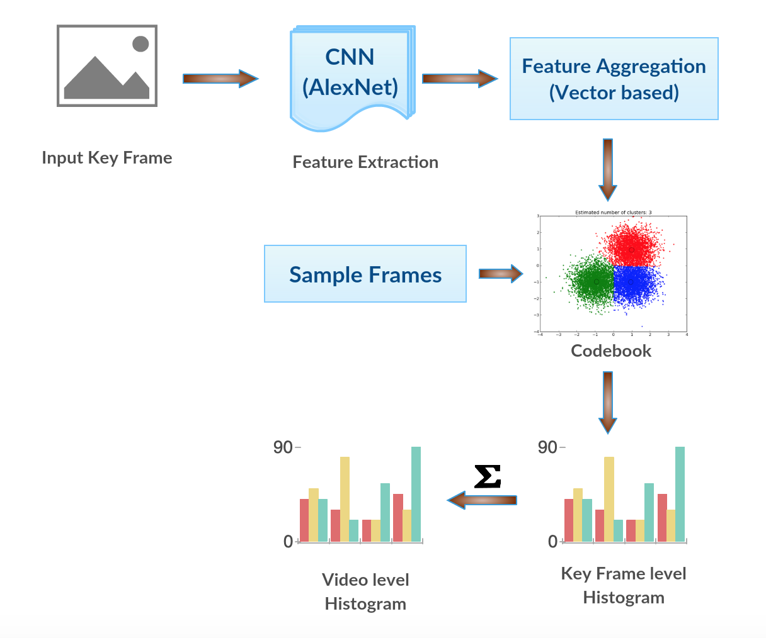
HIGH LEVEL OVERVIEW

Slide 7
OUR APPROACH (explained)
High-level intuition: Bag-of visual words model for each video to generate a codebook and then compare new videos.
Feature Extraction:
Frame feature vector is extracted using CNN
Max-pooling is applied on the intermediate feature maps
Output: Feature vector of 1376 dimensions.
Visual Codebook Generation:
K-means clustering was used to generate visual codebooks (dictionaries) (or any clustering mechanism).
Sample of random 10K frames are used for visual codebook generation (K = 100)

Slide 8
OUR APPROACH (explained)
Key frame → Video-level Histogram Procedure:
For each key frame identify nearest cluster and generate key frame level histogram.
Video level histogram is generated by summing over the individual key frame histograms.
Video Querying for Near Duplicates:
Calculate cosine similarity using TF-IDF between the two video histograms.
Sort in descending order based on similarity score. (Threshold can be used to segregate into categories).

Slide 9
KEY FRAME EXTRACTION METHODS
Sequential Comparison between frames
Compare frame by frame and choose frames with high difference values.
Global Comparison between frames
Minimizes a predefined objective function by using the global difference between frames
Curve Simplification
Represents frames as points in the feature space to formulate a trajectory curve. Key frames are the points that give the best representation to the shape of the curve.
Clustering
Each frame is a data point in the feature space. Cluster frames, then the frames that have smallest distances (closest) to cluster centers are selected.
Notes:
Learn more about turning bullets into visual, here: https://kb.wisc.edu/page.php?id=40426

Slide 10
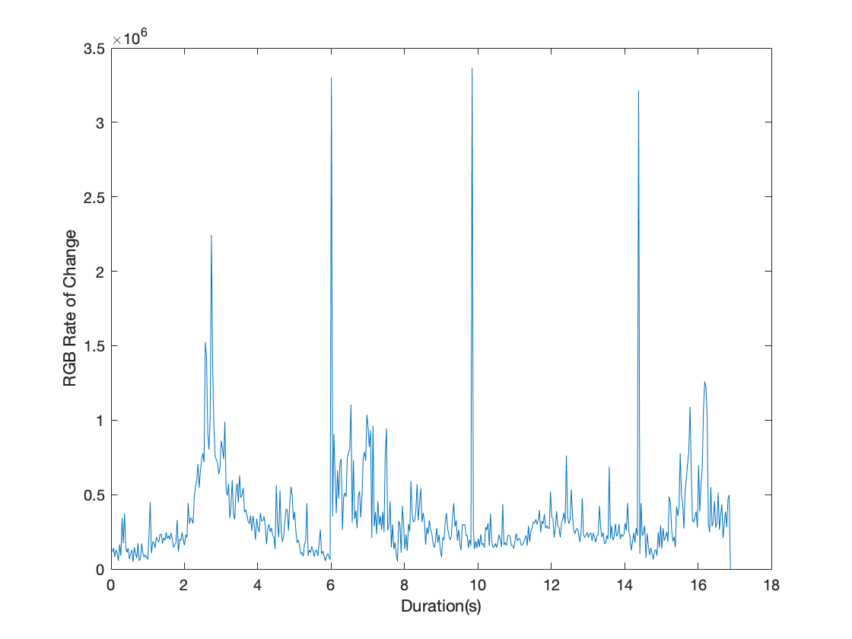
KEY FRAME EXTRACTOR (RESULTS)
Get a difference value for each frame (by comparing with previous frame)
Choose key frames
Top n frames (n - predefined number) ordered by decreasing difference value
Choose all frames with difference value above a predefined threshold
Using local maxima

Slide 11

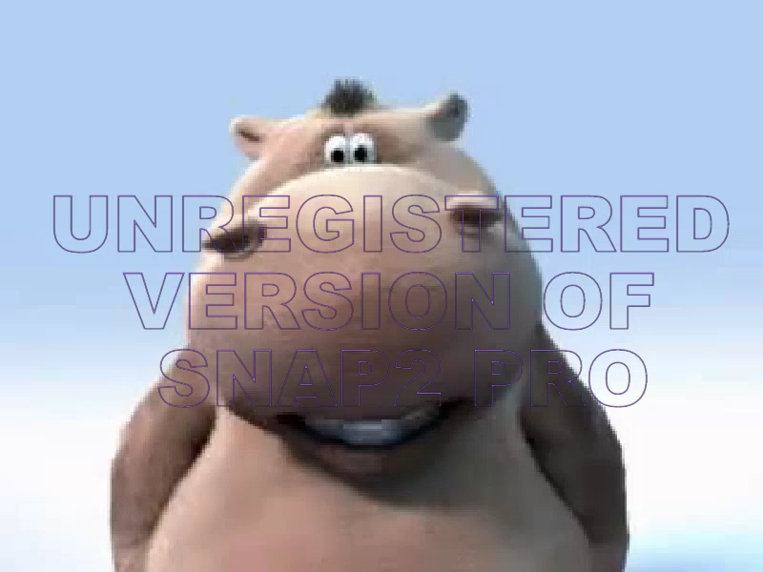
RESULTS
Classified as Near Duplicate Videos (TP)

Slide 12
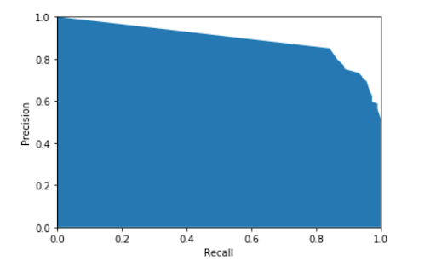
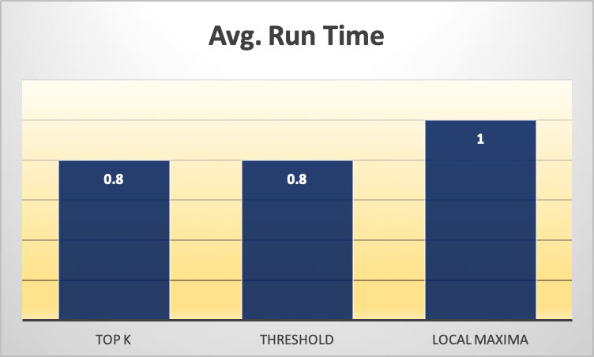
RESULTS (contd.)
Precision-recall curve for query 3
Runtime vs Modified extractors
Key observations
Observed P-R curves for different query sets.
Relatively less standard deviation within the precision set.
Some hard queries will show lower precision due to less representative keyframes (outliers).
Modified Keyframe extractors do not have an adverse impact on precision.
Trade-off observation
Faster Computations vs Lesser accuracy – Choose extractor (1,2) [Youtube]

Slide 13
CONCLUSION & FUTURE WORK
In this project, we implemented a model motivated by vector-based aggregation in a CNN to perform NDVR and observed P-R curves for different query sets.
We also explored several Keyframe extractor techniques to serve as input to the aforementioned CNN model.
Modified Keyframe extractors provide interesting computation opportunities and accuracy vs runtime trade-offs.
In the future, we are considering three directions as follows:
Challenging datasets with different domains of videos (including distractors).
Can we perform NDVR on low-quality video datasets?
Are ensemble mechanisms possible during inference?

Slide 14
THANK YOU

